Slide 1
Information Sharing for Supply Chain Management based on Block Chain Technology
Reporter：薛伟

Slide 2
Part 1 Introduction
Independent firms manage different parts of global supply chains.
Each firm is willing to maximize its own profits.
However, they may not share the information.
For supply chain, more important the information is , harder to get.

Slide 3
Two key problems in Supply Chain
Asymmetric Information
Double marginalization
The paper proposes a blockchain based solution to address the problems of supply chain.
Notes:
双重边际效应是指供应链上、下游企业为了谋求各自收益的最大化，在独立决策的过程中确定的产品价格高于其生产边际成本的现象。
由于供应链不同阶段成员的目标可能发生冲突，供应链中的每个成员在决策时只考虑各自的边际效益，而不考虑供应链中其他成员的边际效益。只要供应链利益在不同成员之间分配时单方决策影响到市场需求，进而导致每一方获利减少，就可以把这种现象称之为“双重边际化”,这是供应链成员不合作的结果。

Slide 4
Part 2 Problem of supply chain
Demand forecasting is becoming difficult because of short product life cycles and long production lead-times. Then, supply chains face the risk of either excess capacity due to low demand realization or lack of product availability.
Some contracts
Notes:
1. payback合约——以一定价格回购未卖出物品
2. 两个是的forecast information sharing可信的合约
a. capacity reservation contract —— 原始制造商信息可信，requiring a fee for reserving capacity.
b. advance purchase agreement原始制造商可以在合约制造商secures capacity之前确定订单价格
c. When degree of forecast information asymmetry is middle level, capacity reservation contract is preferred. And when degree of forecast information asymmetry is high and capacity expansion cost is low, Advance purchase contract is preferred.

Slide 5
Current solution
Data exchange systems for Supply Chain Management
POS (Point of Sales)
EDI (Electronic Data Exchange)
VAN (Value Added Network)
VMI (Vendor Managed Inventory)
It’s hard to keep the information fresh

Slide 6
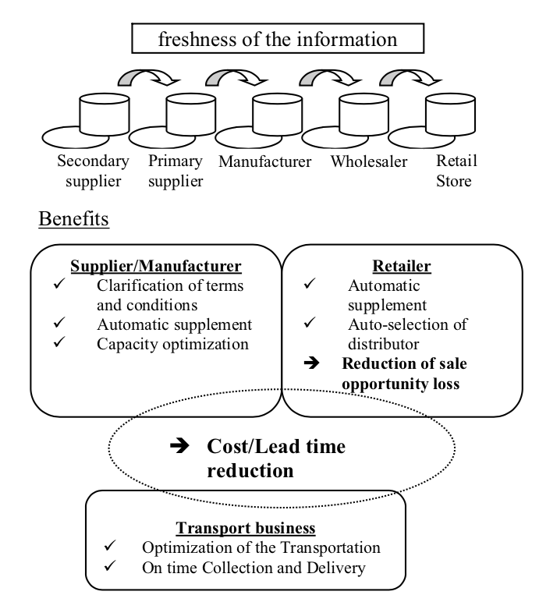

Slide 7
Part 3 Proposed Solution
For satisfying these requirements, we consider low cost and access controllable database system.
In general, information sharing scheme is exclusively tied to the major IT companies serving as the trusted third party who process and mediate any electronic transaction.
Bitcoin mechanism in our system uses cryptographic proof instead of the trust in the third party for two willing parties to execute an online transaction over the Internet.

Slide 8
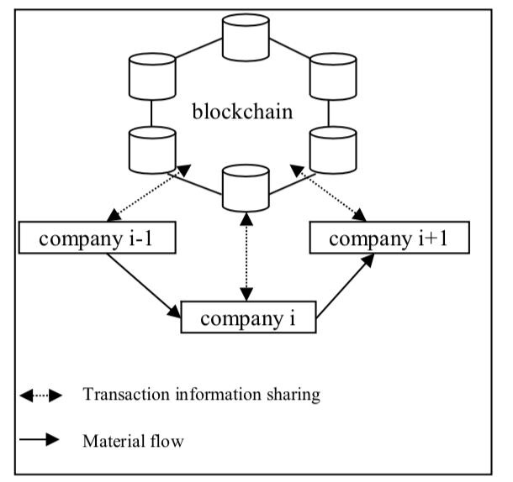

Slide 9
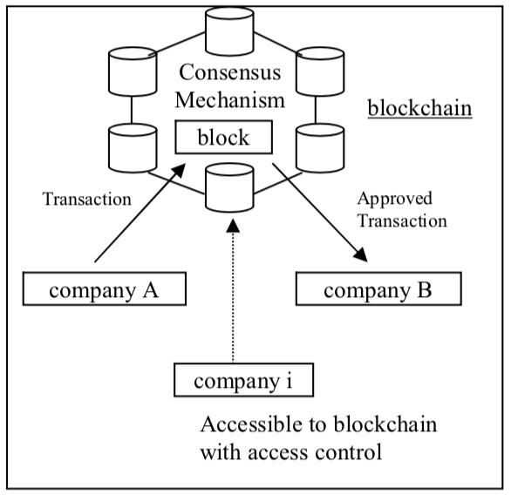

Slide 10
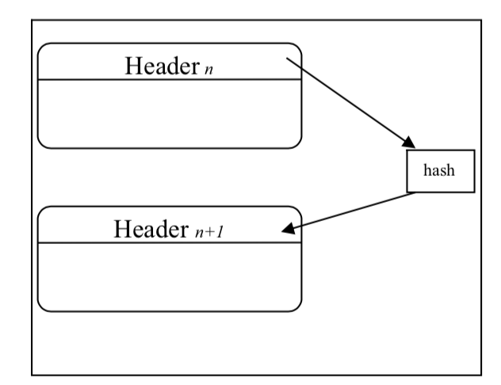
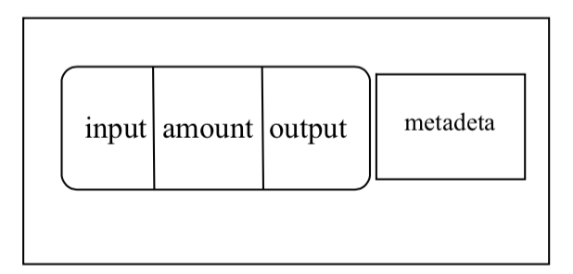
Bitcoin’s implementation
Notes:
1. input: The origin of the amount transacted. (i.e.,vender)
2. output: The destination of the amount transacted (i.e.,customer)
3. amount: Quantity of the unit transacted (in Bitcoin blockchain, the unit is a bitcoin)
4. metadata: Additional information that can be stored along with the transaction (in Bitcoin, this is where relevant information can be added. Generally the metadata consists of a number that refers to a version of digital assets, also called “hash”)

Slide 11
To illustrate the solution, consider the modified blockchain.
Transaction data (i.e. vender, amount, customer/product and conditions) is encrypted using a secret encryption key and sent to the blockchain.
Conditions are agreements with vendors about contract types (such as capacity reservation contract and advance purchase agreement), prices, surcharges and discounts, and so on.

Slide 12
The modified blockchain accepts a new type of transaction for calculation, used for calculating total of selected amount.
It includes homomorphic encryption scheme
Homomorphic encryption is a form of encryption that allows computation on ciphertexts, generating an encrypted result which, when decrypted, matches the result of the operations as if they had been performed on the plaintext. The purpose of homomorphic encryption is to allow computation on encrypted data.

Slide 13
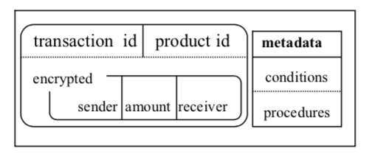
A. Building Blocks
Identities: compound identity.
Owners and guests
B. Blockchain Process
Notes:
Sender, amount and receiver are components of invoice and these are encrypted because the disclosure of these data leads to their disadvantage. Sender and receiver are the parties as supplier, manufacturer, transport business and retailer in supply chain.
Metadata contains the address both conditions and procedures which verifies and/or enforces terms and conditions in the contract.
Condition allows procedures to set trigger events according to terms and conditions in the contract, such as delivery delay. Procedure is executed by nodes in the blockchain network when trigger event is received.

Slide 14
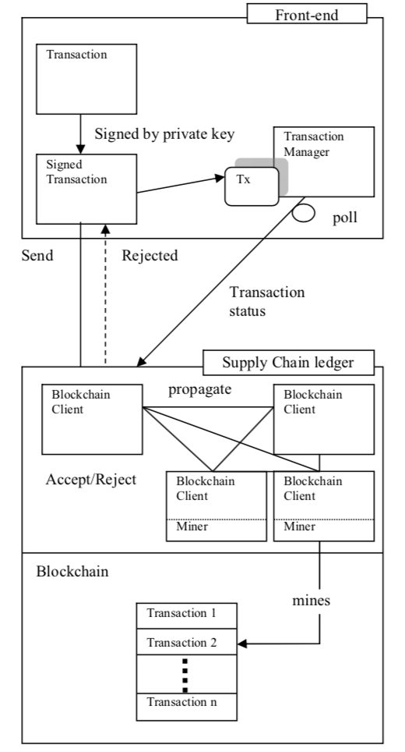
Transaction process:
Notes:
1. Front end application signs and issues transaction to supply chain ledger. Supply chain ledger is the blockchain network and it receives transactions related to the supply chain. He also adds a “transaction id” to the record.
2. Client verifies the transaction and propagates the transaction to other clients.
3. Client also earns the hash for the transaction.
4. Miner can make new block this and other transaction.
5. Transaction Manager on Front-end watch the status of incomplete transactions on its memory space.
6. Transaction Manager creates new transaction when trigger event occurs.

Slide 15
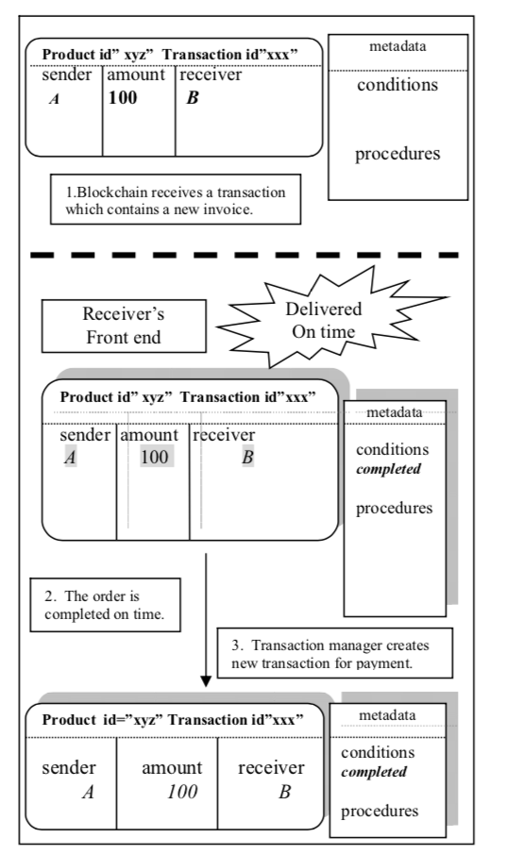
Normal transaction：
Notes:
1. Receiver receives the product.
2. Transaction Manager on Front-end seeks incomplete transactions for the product on its memory space.
3. Transaction Manager copies the transaction and deletes from its memory space.
4. Transaction Manager creates new transaction using the copy.
5. The blockchain client adds this transaction to new block.

Slide 16
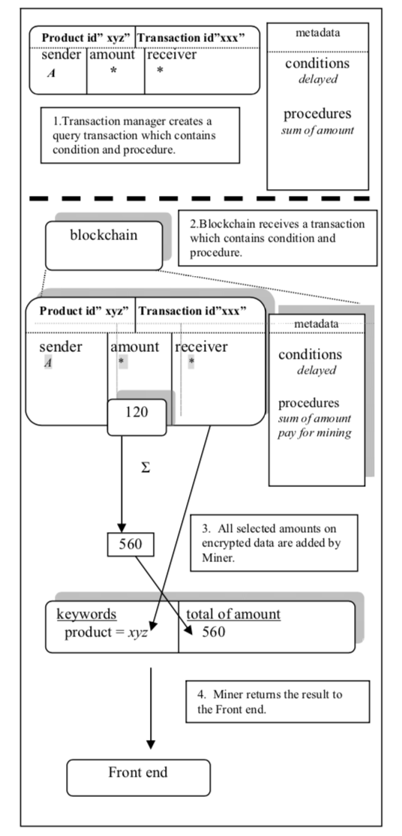
Calculation Transaction：
Notes:
1. Transaction manager creates a query transaction with pay for mining procedure.
2. Miner in the blockchain network seeks incomplete transactions for the query.
3. Miner extracts and sums up all amounts of ordered product.
4. Miner returns the result of request.
5. Transaction manager confirms the result and releases “pay for mining” procedure to pay the charge. The incentive of the process can be funded with transaction fees.

Slide 17
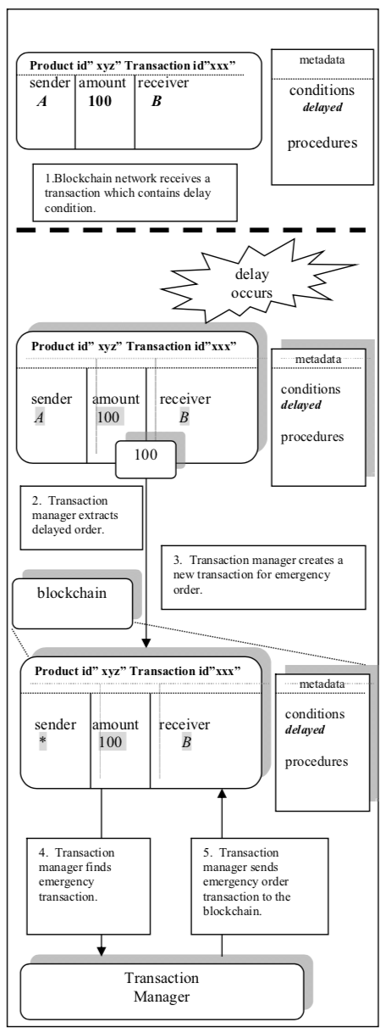
Emergency Order Process
Notes:
Blockchain network receives a transaction which contains delay condition. Transaction manager extracts delayed order.
Transaction manager creates a new transaction for emergency order.
Transaction manager finds emergency transaction.
Transaction manager sends emergency order transaction to the blockchain.

